Slide 1
History of Computer Architecture
ENIAC- 1945: Designed by Mauchly & Echert, built by US army to calculate trajectories for ballistic shells during WWII, used 18000 vacuum tubes and 1500 relays, programmed by manually setting switches
UNIVAC – 1950: the first commercial computer
John Von Neumann architecture: Goldstine and Von Neumann took the idea of ENIAC and developed concept of storing a program in the memory. Known as the “Von Neumann” architecture and has been the basis for virtually every machine designed
Features:
Electron emitting devices
Data and programs are stored in a single read-write memory
Memory contents are addressable by location, regardless of the content itself
Machine language/Assemble language
Sequential execution
Use of drum memory or magnetic core memory, programs and data are loaded using paper tape or punch cards

Slide 2
Two types of models for a computing machine:
Harvard architecture – This has physically separate storage and signal pathways for its instructions and data. (The term invented the Harvard. Mark I(Relay-based computer system, which use punched tape for save store instructions and relay latches for data)

Slide 3
Von Neumann architecture – a single storage structure to hold both the set of instructions and the data. Such machines are also known as stored-program computers.

Slide 4
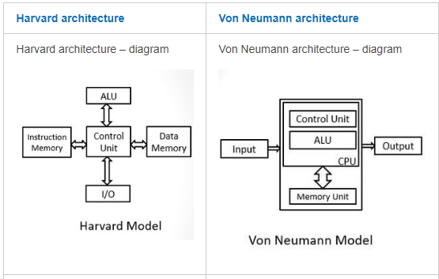

Slide 5
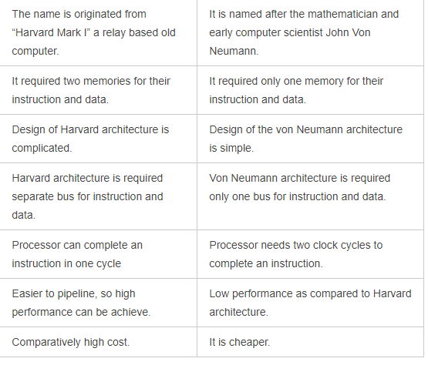

Slide 6
Second Generation (1950-1964) – Transistors
William Shockley, John Bardeen, and Walter Brattain invent the transistor that reduce size of computers and improve reliability.
First operating Systems: handled one program at a time
On-off switches controlled by electricity
High level languages
Floating point arithmetic
Reduced the computational time from milliseconds to microseconds
First operating Systems: handled one program at a time
1959 – IBM´s 7000 series mainframes were the company´s first transistorized computers

Slide 7
Third Generation (1964-1974) – Integrated Circuits (IC)
Microprocessor chips combines thousands of transistors, entire circuit on one computer ship
Semiconductor memory
Multiple computer models with different performance characteristics
Smaller computers that did not need a specialized room
2 Mb memory, 5 MIPS
Use of cache memory
IBM’s System 360 – the first family of computers making a clear distinction between architecture and implementation

Slide 8
Fourth Generation (1974-present) Very Large-Scale Integration (VLSI)/Ultra Large Scale Integration (ULSI)
Combines millions of transistors
Single-chip processor and the single-board computer emerged
Creation of the Personal Computer (PC)
Wide spread use of data communications
Artificial intelligence: Functions & logic predicates
Object-Oriented programming: Objects & operations on objects
Massively parallel machine
Smallest in size because of the high component density

